Slide 1


Curved Bregman divergences and their applications
Frank Nielsen
Sony Computer Science Laboratories, Inc.
Geometric Science of Information
31st October 2025

Slide 2
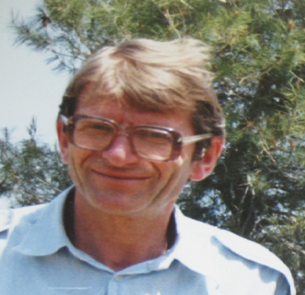

Bregman divergences (1960’s)
F: Θ⊆ℝ^{m}→ℝ a strictly convex and smooth
real-valued function on a finite dim. Hilbert space <.,.>
Bregman divergence B_{F}: Θ x RelativeInterior(Θ) →ℝ_{≥0}
Lev M. Bregman
(1941 - 2023)
Photo: courtesy of
Alexander Fradkov
B_{F}(θ₁ : θ₂)=F(θ₁)-F(θ₂)-< θ₁ - θ_{2 ,} ∇F(θ₂) >
Smooth measure of discrepancy, not a metric distance because it violates the triangle inequality.
BD is asymmetric when F is not quadratic function. Hence the delimiter notation “:” instead of B_{F}(θ₁ , θ₂)
BD interpreted as remainder of a first order Taylor expression of F(θ₁) around θ₂:
F(θ₁)=F(θ₂)+< θ₁ - θ_{2 ,} ∇F(θ₂) >+ B_{F}(θ₁ : θ₂)
Taylor remainder
Example of remainder: Lagrange remainder (smooth C² generators): ∇²F SPD ⇒ B_{F}(θ₁ : θ₂) ≥ 0
B_{F}(θ₁ : θ₂)= ½ (θ₂- θ₁)^{T} ∇²F(θ) (θ₂- θ₁) ≥0 , θ ∈ [θ₁ θ₂]
Notes:
https://en.wikipedia.org/wiki/Mathematical_operators_and_
ℝ
symbols_in_Unicode
Θθ∇≻ξ∈
http://lib.physcon.ru/doc?id=5d34ad008433
Σ
Lev Meerovich Bregman
(1941 - 2023)

Slide 3



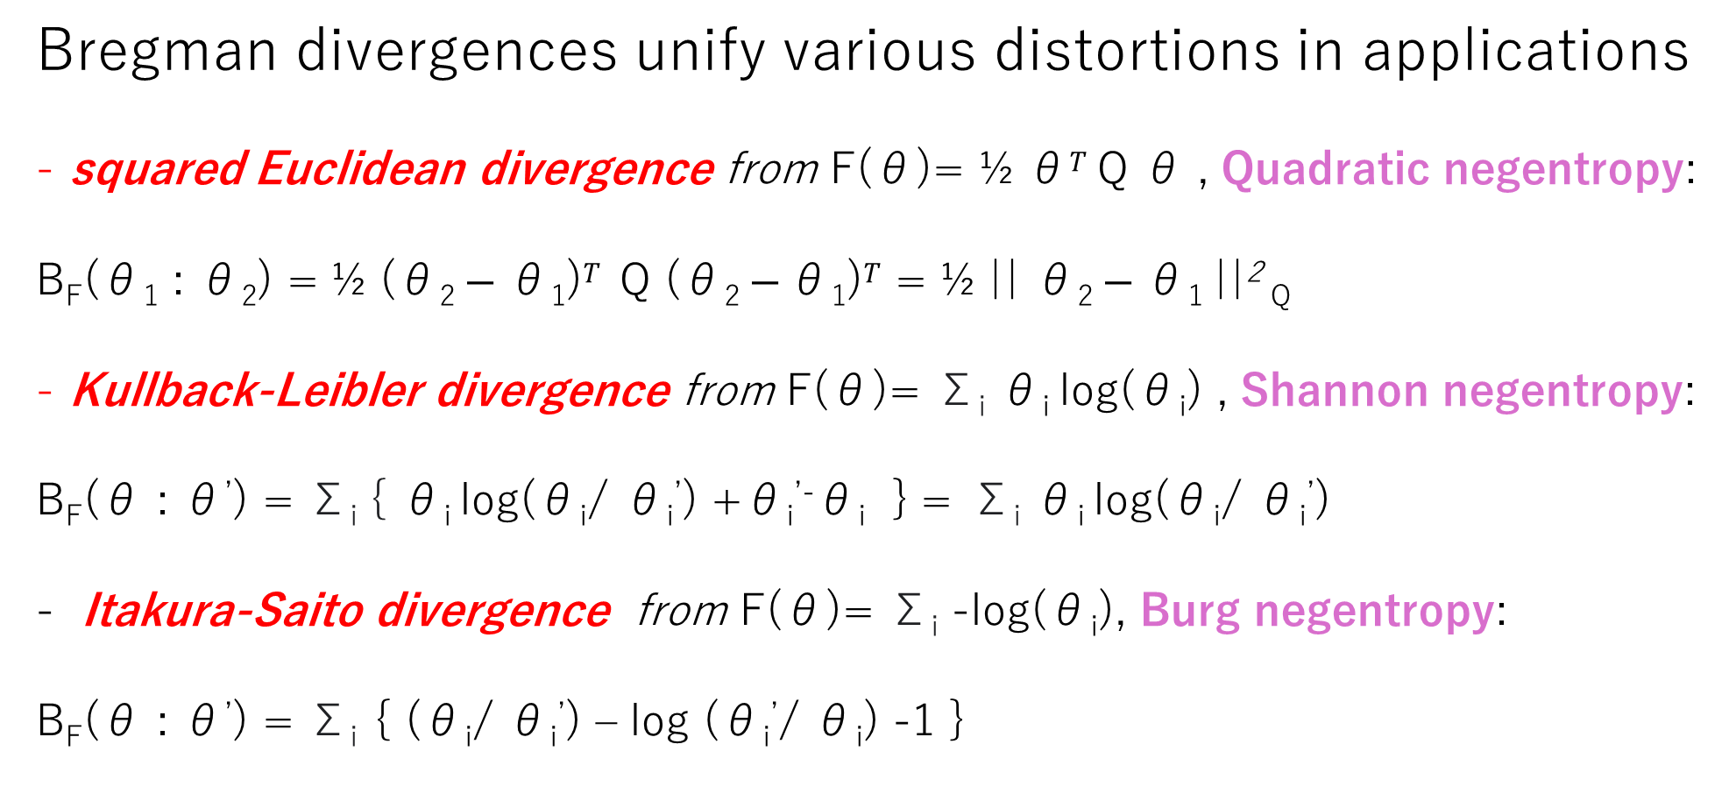
BDs: A versatile class of dissimilarities
Bregman divergences unify various distortions in applications
squared Euclidean divergence from F(θ)= ½ θ$T$ Q θ , Quadratic negentropy:
B_{F}(θ₁ : θ₂) = ½ (θ₂ $− \text{θ}\text{1}\text{)}T$ Q (θ₂ $− \text{θ}\text{1}\text{)}T$ = ½ || θ₂ $− \text{θ}\text{1} \text{||}$² _{Q}
Kullback-Leibler divergence from F(θ)= Σ_{i} θ_{i} log(θ_{i}) , Shannon negentropy:
B_{F}(θ : θ’) = Σ_{i} { θ_{i} log(θ_{i}/ θ_{i}’) +θ_{i}^{’-}θ_{i} } = Σ_{i} θ_{i} log(θ_{i}/ θ_{i}’)
Itakura-Saito divergence from F(θ)= Σ_{i} -log(θ_{i}), Burg negentropy:
B_{F}(θ : θ’) = Σ_{i} { (θ_{i}/ θ_{i}’) – log (θ_{i}’/ θ_{i}) -1 }
Notes:
Q SPD,

Slide 4
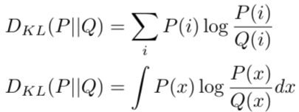

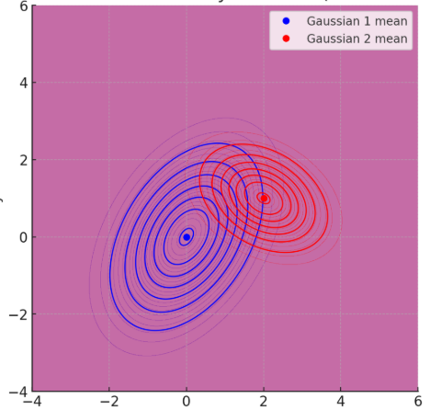
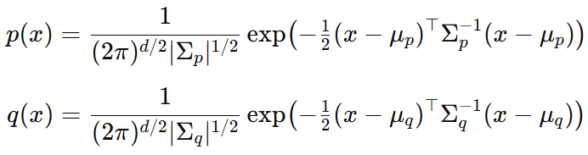
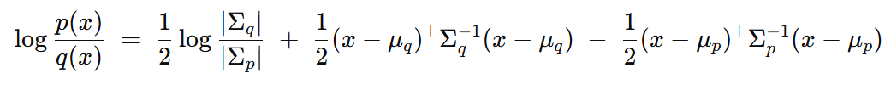
Relative entropy between Gaussian distributions?
Relative entropy = cross-entropy minus entropy, a dissimilarity measure in information theory, statistics, ML, etc.
called Kullback-Leibler divergence (KLD) in information theory:
How to calculate the KLD between multivariate Gaussian distributions?
D_{KL}[p(x):q(x)]= ∫ p(x) log (p(x)/q(x)) dμ(x)
KLD integrals ∫ is non-trivial but….
We need expectation wrt p(x) of this term !?
Notes:
a f-divergence for f(u)=-log u

Slide 5

BDs first impacts in ML: Link with exponential families
Kullback-Leibler divergence between two probability densities:
D_{KL}[p(x):q(x)]= ∫ p(x) log (p(x)/q(x)) dμ(x)
can be difficult to calculate in closed form because of the integral ∫
But Kullback-Leibler divergence between two probability densities of an exponential family with densities p(x| θ) = exp( <t(x), θ >-F(θ) )
amount to a reverse Bregman divergence B_{F}^{rev}(θ₁ : θ₂) := B_{F}(θ₂ : θ₁)
where F is the cumulant function (log partition/log Laplace function)
D_{KL}[p(x|θ₁) : p(x|θ₂) ] = B_{F}^{rev}(θ₁ : θ₂) = B_{F}(θ₂ : θ₁)
BDs wrt CFs between parameters = reverse KLD distributions
⇒ Easy calculations of KLDs
Bypass the ∫, ∇F in BD easy to calculate!
Azoury, Katy S., and Manfred K. Warmuth. "Relative loss bounds for on-line density estimation with the exponential family of distributions." Machine learning 43 (2001)
Notes:
∫μ
∇F easy!
Information geometry proves that B_{F}(θ₁ : θ₂)= D_{KL}*[p(x|θ₁) : p(x|θ₂) ]
when F(θ)=log ∫ exp(<x, θ >) dμ(x) where D_{KL}*[p(x):q(x)]:= D_{KL}[q(x):p(x)] is the reverse Kullback-Leibler divergence

Slide 6

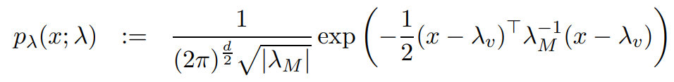

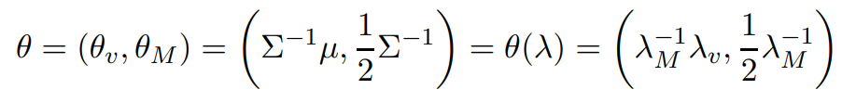
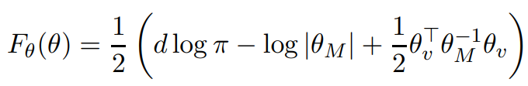
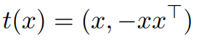
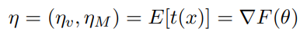
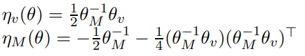

Example: KLD between Gaussians from BD
D_{KL}[p(x|θ₁) : p(x|θ₂) ] = B_{F}(θ₂ : θ₁)
p(x| θ) = exp( <t(x), θ >-F(θ) )
Non-unique canonical decomposition:

Slide 7

Representational Bregman divergences (2009)
In fact, we used a representation function R (e.g., θ(λ )) for
Calculating the KLD between two multivariate normal distributions:
B_{F,R}(λ ₁ : λ ₂):= B_{F}(R(λ ₁ ):R(λ ₂))
= F(R(λ ₁))-F(R(λ ₂))-< R(λ ₁)–R(λ ₂ ),∇F(R(λ ₂) ) >
Note that F∘R may not be a Bregman generator, i.e., not be strictly convex.
KLD between two densities of a generic exponential family with natural parameter from representation function
θ(λ ): natural parameter corresponding to λ, representation function R(.)=θ(. )
include normal, Gamma/Beta, Wishart, Poisson, etc.
D_{KL}[p(x| λ ₁) : p(x| λ ₂) ] = B_{F,} _{θ} ^{rev}(θ (λ ₁): θ (λ ₂))=B_{F,} _{θ}(θ (λ ₂): θ (λ ₁))
Notes:
Λ
A *representational Bregman divergence* is a Bregman divergence applied on a representation of the parameter space.
The α-divergences extended positive measures are an example of representational Bregman divergences.
Dual representational Fenchel-Young divergence with dual representation function
But restricted to the (m-1)-dimensional probability simplex is not a
Nielsen, Frank, and Richard Nock.
"The dual Voronoi diagrams with respect to representational Bregman divergences." IEEE ISVD 2009

Slide 8
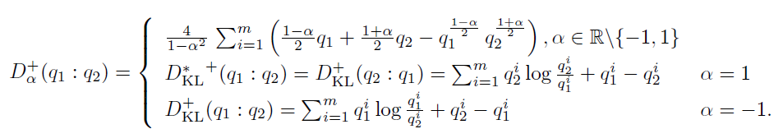
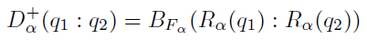
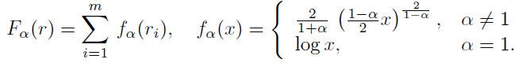
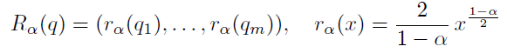
Extendedα-divergences are representational BDs
α-divergences extended to m-dim. positive measures (orthant cone)
are representational Bregman divergences:
Bregman generator:
Representation function:
Bregman divergence:
B_{F}(θ₁ : θ₂)=F(θ₁)-F(θ₂)-< θ₁ - θ_{2 ,} ∇F(θ₂) >
"The dual Voronoi diagrams with respect to representational Bregman divergences." IEEE ISVD 2009

Slide 9
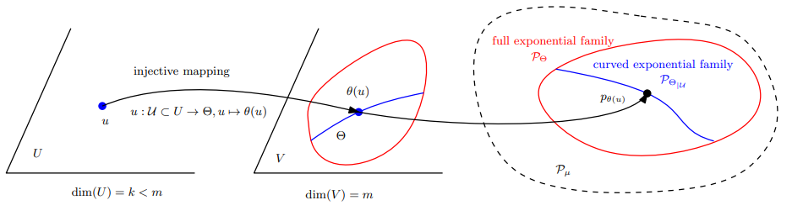
Curved Bregman divergences (cBDs)
Consider a domain U which maps to a subset of Θ by θ =c(u) with dim(U) < dim(Θ) : B_{F,c}(u₁ : u₂) := B_{F}(c(u₁ ):c( u₂)) is not Bregman when {c(u) | u ∈ U} not convex. cBDs usually not BDs unless constraints c(.) are affine
By analogy to curved exponential families
For example, U is real vector space, V is symmetric matrix vector space, CEF is sub-family of Gaussians
Notes:
Example:
KLD between 0-centered normal distributions with covariance matrices c(λ)=λΣ

Slide 10
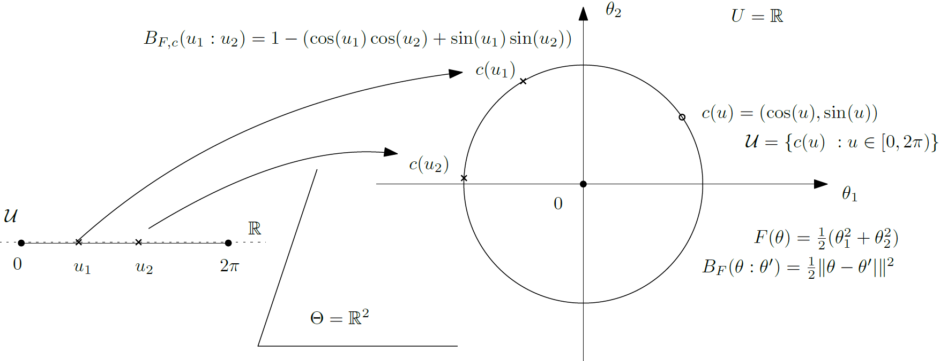
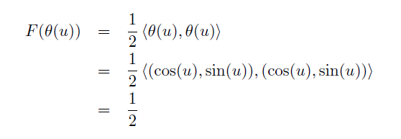
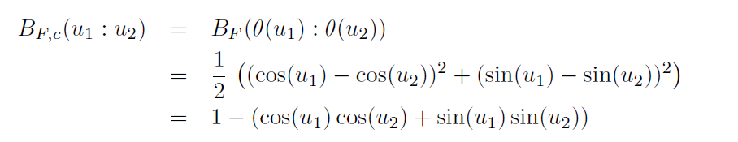
Toy example: curved circle Euclidean divergence
A toy example: Curved circle Euclidean divergence
Not a Bregman divergence
A constant, thus not a Bregman generator!

Slide 11
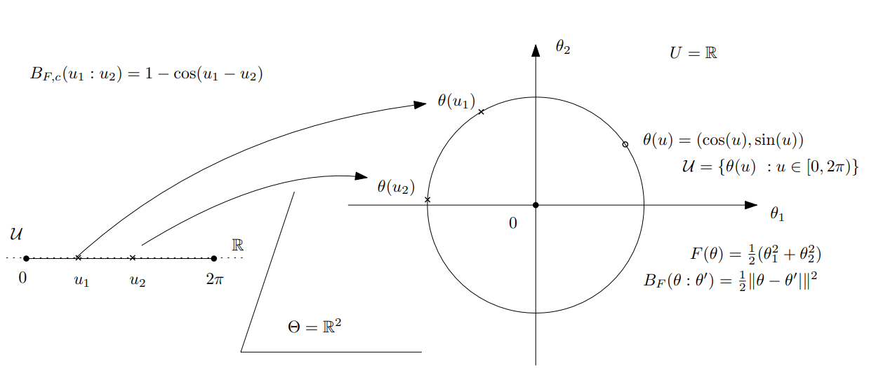

Curved Bregman divergence example: The cosine dissimilarity between unit vectors
Curved Bregman divergence:
Not a Bregman divergence
arXiv:2504.05654
A constant on the circle submanifold, thus not a proper Bregman generator!

Slide 12
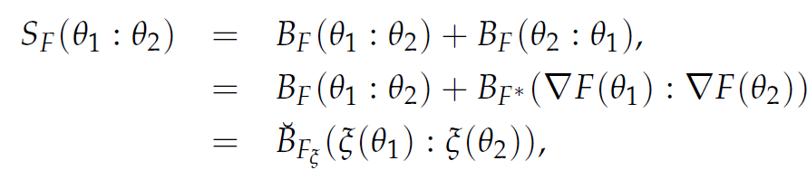
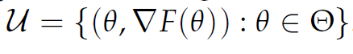
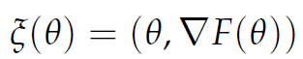
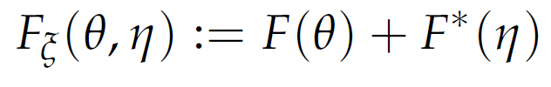
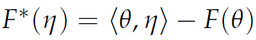
Example of curved BDs: Symmetrized BDs
= Jeffreys-Bregman divergences are curved Bregman divergences:
S_{F}(θ₁ ,θ₂)=< θ₁ -θ₂ ,η₁ -η ₂ >
Curved domain:
m-dimensional submanifold in 2m-dimensional space
(usually not cvx affine space, hence not a Bregman divergence)
Only affine for quadratic generators (squared Mahalanobis divergences)
“Sided and symmetrized Bregman centroids.” IEEE transactions on Information Theory 55.6 (2009)

Slide 13
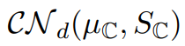
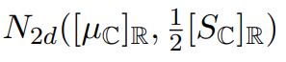
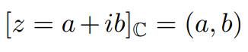
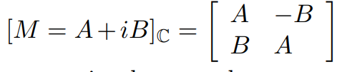


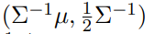
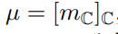

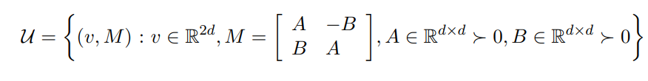
Another example of curved Bregman divergences:
Consider d-variate circular complex normal distributions
CNDs handled as 2d real normal distributions
Then KLD between CNDs amounts to a curved Bregman divergence:
Curved submanifold parameter in R^{2d} x Mat(2d)
Natural parameters
2504.05654
See also Nakashika, T: "Complex-Valued Variational Autoencoder: A Novel Deep Generative Model for Direct Representation of Complex Spectra.“
INTERSPEECH. 2020.
Notes:
Kullback-Leibler distance between complex generalized Gaussian distributions

Slide 14
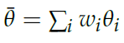
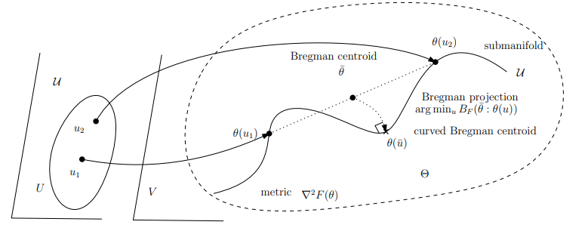
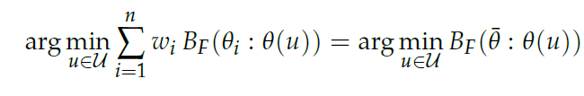
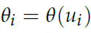
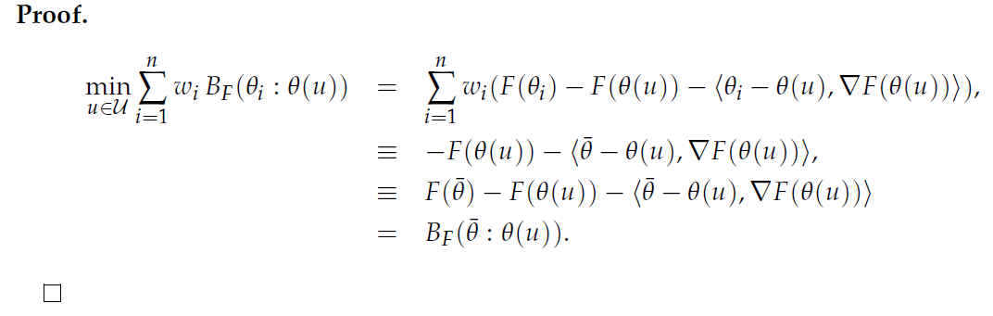
Curved Bregman centroid is the Bregman projection of the full Bregman centroid
Bregman projection
Theorem:
)
N-point opt.
One-point opt!
"What is... an information projection?" Notices of the AMS 65.3 (2018): 321-324.

Slide 15


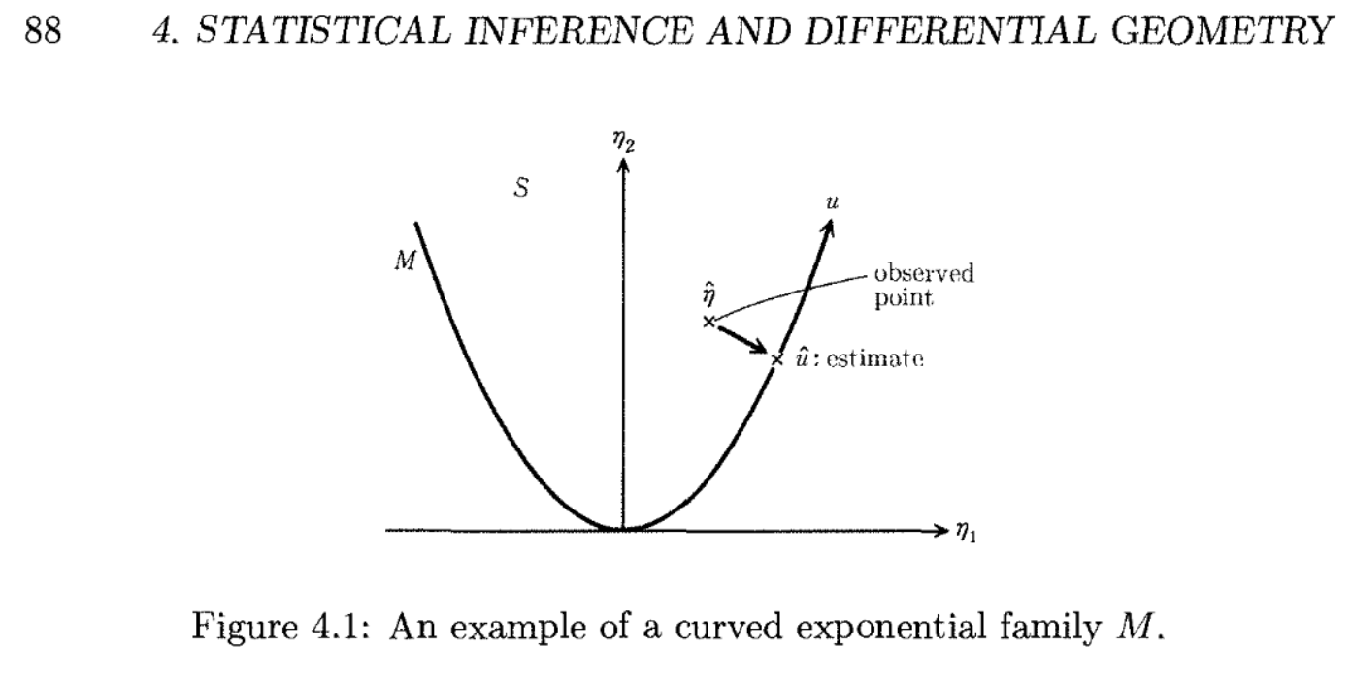
Usually duality of regular BD with regular EF
Projection theorem of MLE for curved EFs
https://arxiv.org/abs/1203.5181

Slide 16
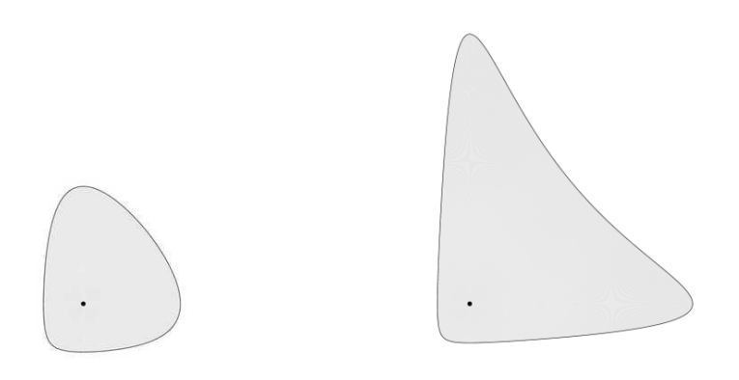
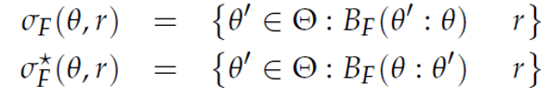
Space of Bregman balls
Example:
Itakura-Saito right and left spheres
Right-sided Bregman ball:
≤
Left-sided Bregman ball:
≤
Application: Boolean algebra of unions & intersections of Bregman balls

Slide 17

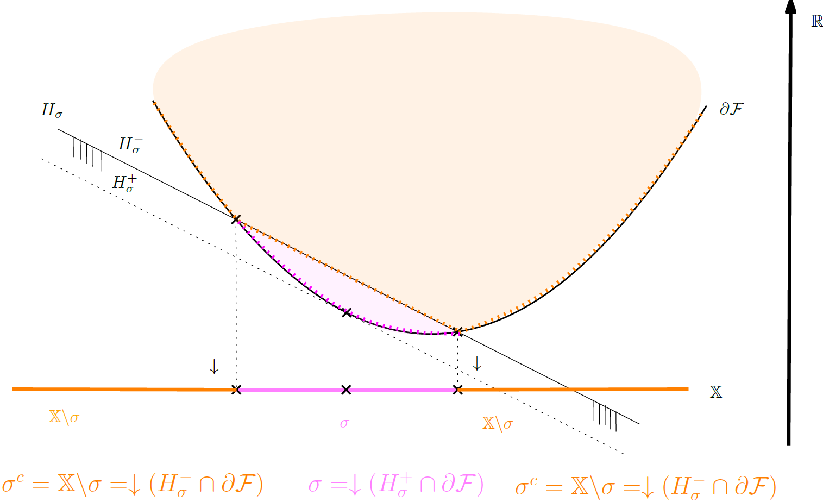
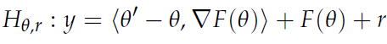
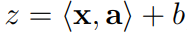
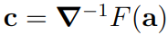
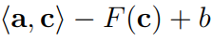
Lifting to potential Bregman generator graph & vertical projection
Right Bregman ball and its complement
↓ means vertical projection
S^{c}: complement of set S
To any sphere, associate a hyperplane:
Reciprocally, to a hyperplane cutting the
function graph, associate a sphere
Center:
Radius:

Slide 18
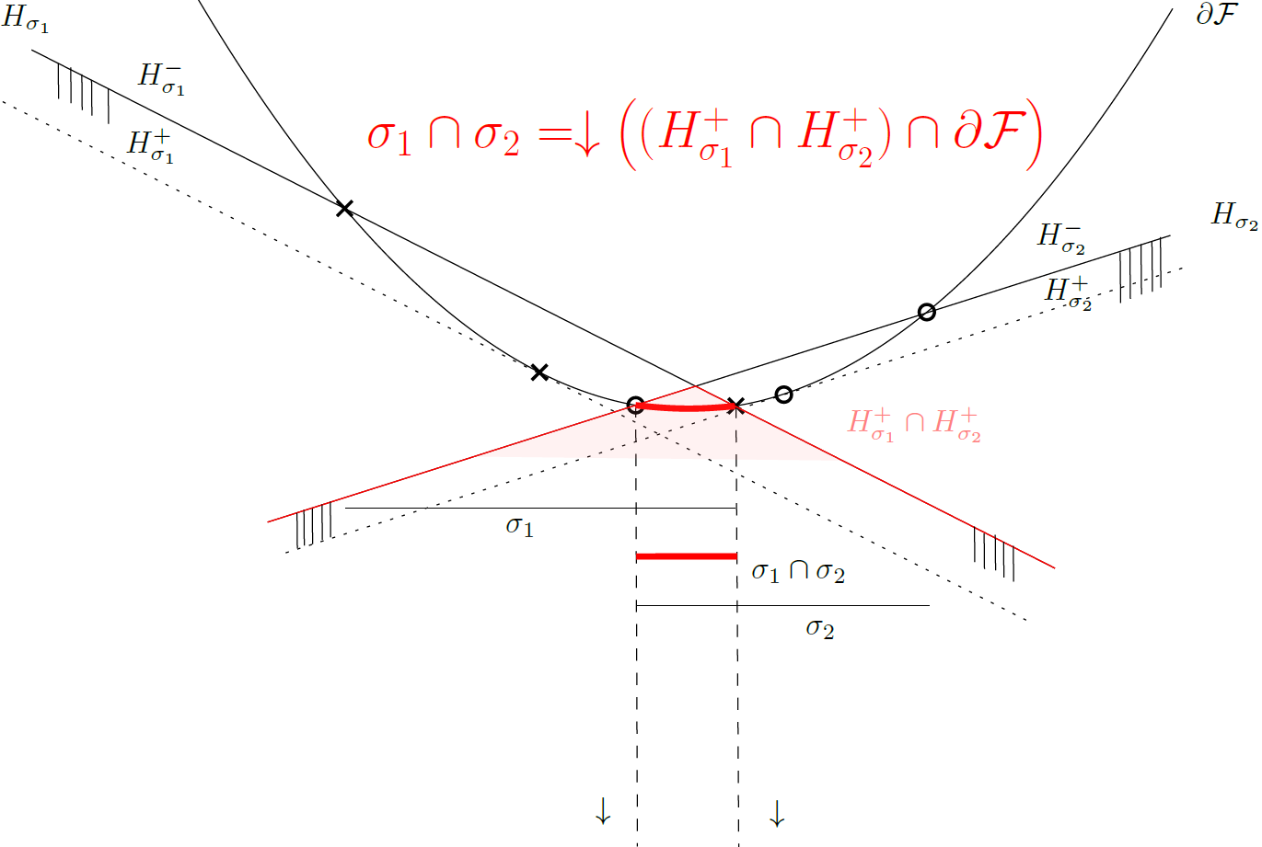
Intersection of two right Bregman balls
Boolean algebra:
intersection of spheres

Slide 19
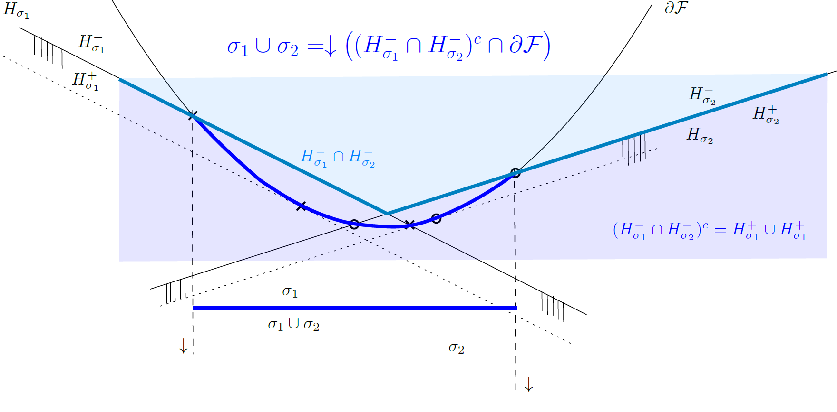
Union of two right Bregman balls
Boolean algebra:
Union of spheres
Set Morgan’s law: (A ∪ B)^{c} = A^{c} ∩ B^{c}
Complement of halfspace (H⁺)^{c}=H⁻
Notes:
De Morgan laws for sets

Slide 20
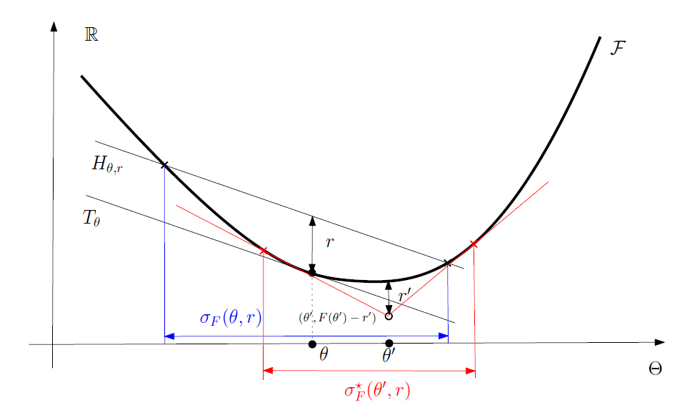
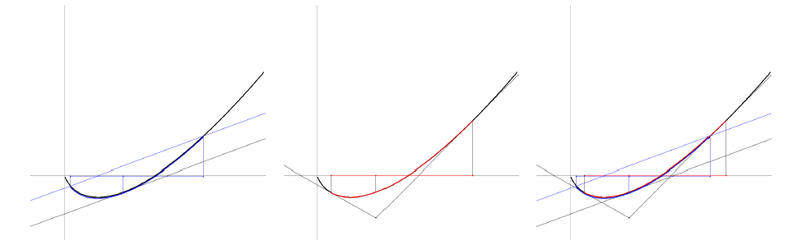
Dual Bregman balls
Example:
Shannon negentropy

Slide 21

Thank you!
Consider space of representational BD balls (alpha-divergences)
Notes:
Vauban 1, 11h40

Slide 22



Slide 23

Geometric interpretation of BD as a vertical gap on the graph (θ,F(θ)):
B_{F}(θ₁ : θ₂)=F(θ₁) - (F(θ₂)+< θ₁ - θ_{2 ,} ∇F(θ₂) >)
= T_{θ2}(θ₁) : Tangent of the function graph at θ₂ evaluated at θ₁
The chord gap divergence and a generalization of the Bhattacharyya distance, IEEE ICASSP 2018

Slide 24

Geometric interpretation of BD as a vertical gap on the graph (θ,F(θ)):
B_{F}(θ₁ : θ₂)=F(θ₁) - (F(θ₂)+< θ₁ - θ_{2 ,} ∇F(θ₂) >)
= T_{θ2}(θ₁) : Tangent of the function graph at θ₂ evaluated at θ₁
Design novel divergences from graph of convex functions…
Example: Bregman chord divergence with application: zero-order optimization in ML
The chord gap divergence and a generalization of the Bhattacharyya distance, IEEE ICASSP 2018

Slide 25
Families of Bregman divergences: β-divergences
squared Euclidean divergence
（ext.) Kullback-Leibler divergence
Itakura-Saito divergence
Bregman generator F_{β}(θ)= θ^{β}/(β(β-1)) – θ/ (β-1) + 1/ β, β ∈ R - {0, 1}
β-divergence: B_{Fβ}(θ₁: θ₂)= (θ₁ ^{β}+ (β-1) θ₂ ^{β}- β θ₁ θ₂ ^{β-1)}/(β(β-1)) , R - {0, 1}
Allows one to unify various algorithms
Learn/tune scalar parameterβ depending on applications & datasets (ad hoc β)
β
β=2
β=1
β=0
Imre Csiszár, "Why least squares and maximum entropy? An axiomatic approach to inference for linear inverse problems." The annals of statistics 19.4 (1991): 2032-2066. [Theorem 4, page 2046]
Notes:
β-divergences, learn β
Thm 4 p 2046 of
Csiszar, Imre. "Why least squares and maximum entropy? An axiomatic approach to inference for linear inverse problems." The annals of statistics 19.4 (1991): 2032-2066.

Slide 26


Generalized Legendre transforms (2009)

Slide 27



Generalized Artstein-Avidan—Milman Legendre transforms
where
is the Legendre-Fenchel transform
Shiri Artstein-Avidan and Vitali Milman. The concept of duality in convex analysis, and the
characterization of the Legendre transform. Annals of mathematics, 169:661–674, 2009.

Slide 28






Generalized Artstein-Avidan—Milman Legendre transforms
where
Affine-deformed convex functions of both argument and returned value remain convex:
arXiv:2507.20577

Slide 29


Slide 30
Bregman divergences in machine learning…
Kullback-Leibler divergence between two probability densities:
D_{KL}[p(x):q(x)]= ∫ p(x) log (p(x)/q(x)) dμ(x)
is difficult to calculate in closed form because of the integral ∫ …
But Kullback-Leibler divergence between two probability densities of a natural exponential family
amount to a reverse Bregman divergence B_{F}^{rev}(θ₁ : θ₂):= B_{F}(θ₂ : θ₁)
D_{KL}[p(x|θ₁) : p(x|θ₂) ] = B_{F}^{rev}(θ₁ : θ₂) = B_{F}(θ₂ : θ₁)
⇒ Easy calculations of KLDs
with densities p(x| θ) ∝ exp(<x, θ >)
Bypass the ∫, ∇F in BD easy to calculate!
Azoury, Katy S., and Manfred K. Warmuth. "Relative loss bounds for on-line density estimation with the exponential family of distributions." Machine learning 43 (2001)
Notes:
∫μ
∇F easy!
Information geometry proves that B_{F}(θ₁ : θ₂)= D_{KL}*[p(x|θ₁) : p(x|θ₂) ]
when F(θ)=log ∫ exp(<x, θ >) dμ(x) where D_{KL}*[p(x):q(x)]:= D_{KL}[q(x):p(x)] is the reverse Kullback-Leibler divergence

